Slide 1





NGS read alignment
Vivek Iyer
Human Genetics Informatics
Wellcome Sanger Institute
vvi@sanger.ac.uk
In the footsteps of Anthony Doran
Notes:
Introduction and title

Slide 2
NGS read alignment
The most important first step in understanding next-generation sequencing data is the initial alignment or assembly that determines whether an experiment has succeeded and provides a first glimpse into the results.
Flicek & Birney, 2009. Nature Methods
Sequence alignment in NGS is:
Process of determining the most likely source of the observed DNA sequencing read within the reference genome sequence.
Principles and approaches to sequence alignment have not changed much since 80’s
Notes:
Let’s open with an expansive quote from two ABSOLUTE GIANTS in the field.
Just for reference, this is what Sequence alignment is. It’s the process of determining the most likely source of the observed DNA Seq read …
NOTE that I’m already speaking a bias in the way I view the work, in that I’m tethered to A reference,
AND you don’t have to have the bias
But you DO have to listen to the talk.
Principles approaches haven’t changed.
Actually that’s bollocks: the methods (approaches) have changed a lot

Slide 3
Overview
Intro - REFERENCES
Methods / Aligners
Alignment Outputs
Alignment Viewers
NGS Workflows, QC and BAM Improvement
Notes:
The talk is long, but we’ll take breaks.
Long because it touches on a few quite distinct bits that all stitch together:
How it’s done,
How to watch the outputs (raw alignments or from a viewer)
How NGS data is prepared before analysis: alignment is only one step.

Slide 4
The reference is key in all that follows
Sequence alignment in NGS is:
Process of determining the most likely source of
the observed DNA sequencing read
within
the reference genome sequence
Notes:
FOR ME, this is alignment:
The reference is key.
We are deeply biased here, in that we always operate in the context of a reference.

Slide 5
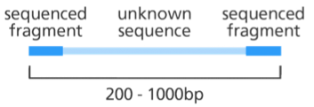
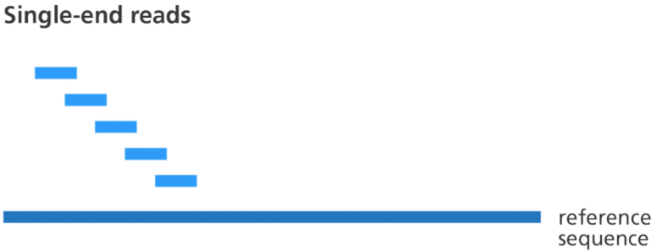
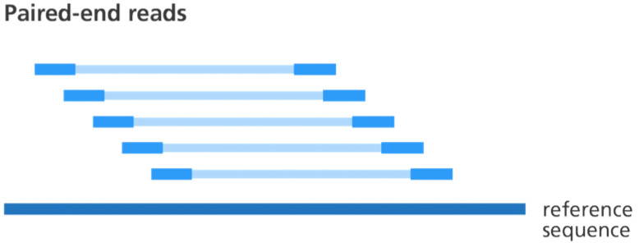
The reference is key in all that follows
Image credit: Genome Research Limited
The view of alignment in this lecture is wildly asymmetric:
short read sequences
very long reference sequences. Genomes (~Gbp) or Transcriptomes (~100Mbp)
Where do references come from?
Organism => Consortium => Money => Sequencing => Assembly => Curation=> Dissemination => Curation, Dissemination => …
Human, Mouse, Zebrafish, Chicken:
Lots of curation / dissemination was done at various centres and distributed by NCBI. NCBI still distributes!
Now the umbrella for curation / patching is: Genome Reference Consortium
Notes:
That was just words, but this is the picture in my head. Little blue boxes are (relatively short) sequence reads – could be 75bp or 150bp or a few hundred – to kilobases
The big blue line is a REFERENCE: most of the time will be aligning to a genome (sometimes not). Where does the reference come from? Depends on the organism.
Individual centres do the sequencing (grant funding) and assembly. Creation of a reference involves sequencing and assembly.
In the past NCBI did a lot of assembly / curation / distribution for human, mouse:
Overall coordination now passed to the GRC!! What’s the GRC? It’s a shell company for genome annotation curators at different institutes: BROAD, SANGER, NIH, NHGRI, etc

Slide 6
The reference is key in all that follows
Image credit: Genome Research Limited
The view of alignment in this lecture is wildly asymmetric:
short read sequences
very long reference sequences. Genomes (~Gbp) or Transcriptomes (~100Mbp)
Where do references come from?
Organism => Consortium => Money => Sequencing => Assembly => Curation=> Dissemination => Curation, Dissemination => …
Human, Mouse, Zebrafish, Chicken:
Lots of curation / dissemination was done at various centres and distributed by NCBI. NCBI still distributes!
Now the umbrella for curation / patching is: Genome Reference Consortium
TREE OF LIFE PROGRAM AT SANGER WILL CHANGE THIS FOREVER
Notes:
That was just words, but this is the picture in my head. Little blue boxes are (relatively short) sequence reads – could be 75bp or 150bp or a few hundred – to kilobases
The big blue line is a REFERENCE: most of the time will be aligning to a genome (sometimes not). Where does the reference come from? Depends on the organism.
Individual centres do the sequencing (grant funding) and assembly. Creation of a reference involves sequencing and assembly.
In the past NCBI did a lot of assembly / curation / distribution for human, mouse:
Overall coordination now passed to the GRC!! What’s the GRC? It’s a shell company for genome annotation curators at different institutes: BROAD, SANGER, NIH, NHGRI, etc

Slide 7
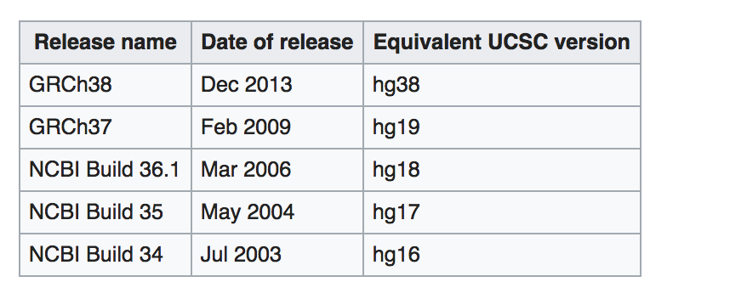
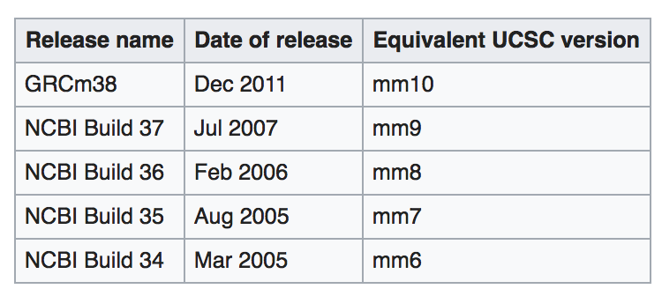
The reference is key in all that follows
Image credit: Genome Research Limited
HUMAN reference sequences
MOUSE reference sequences
The actual reference is a just a (big) sequence (fasta) file: $ ls –h GRCh38.fa
> 3.1G GRCh38.fa
Notes:
What does this consortium EMIT?
Versioned assemblies.
I’ve listed the names and dates of human assemblies. You can see that although the current one (h38) was emitted 5 years ago, …
For mouse, the situation is a lot easier and saner.
What is an assembly? It’s basically a big fasta file (you were dealing with fasta this morning)

Slide 8
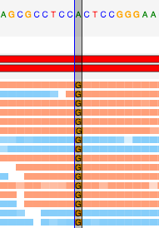
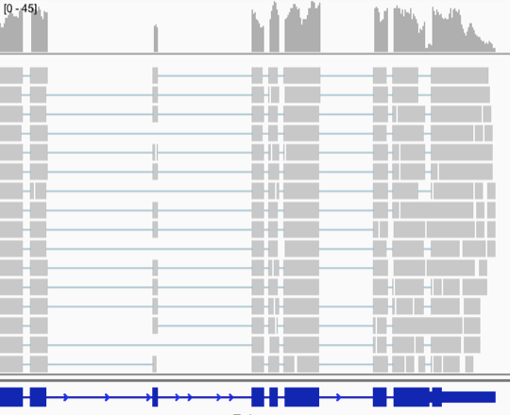
Why align?
Image credit: Genome Research Limited
Align DNA: Identify variation
ALIGN RNA: Transcript abundance
Notes:
ONCE YOU HAVE A REFERENCE,
THEN you can align read to it.
AND THESE are typical inferences you can make with alignment:
Variation from the reference – could have functional consequence.
Transcript abundance: Very common to use alignment to genome to quantify transcript expression.

Slide 9
Overview
Intro
Methods / Aligners
Alignment Outputs
Alignment Viewers
NGS Workflows, QC and BAM Improvement

Slide 10
Local alignment: Smith-Waterman algorithm (1981)
Algorithm for generating the optimal pairwise alignment between two sequences
Optimal alignment: the alignment which exhibits the most correspondences and the least differences, i.e. the alignment with the highest mapping score
Time consuming to carry out for every read - impractical
Aligner will use it to refine a quick approximate placement
Variant caller might use it to correctly re-align reads with insertions/deletions
EVEN SO, We will now get a feel for this
Notes:
I will SKETCH three alignment methods now.
The first SMITH-WATERMAN is the easiest to demonstrate, because we can all watch it go.
It is an algorithm for generating the optimal pairwise alignment between two sequences.
And by OPTIMAL we mean the alignment which optimises a score, which reflects the most correspondences and the least differences.
It’s easy to demonstrate, BUT it’s very slow to carry out for every read, so in practice, these days,
it’s only carried out for a subset of reads, when the aligner at the end is trying to finesse its results.

Slide 11
Local alignment: Smith-Waterman algorithm (1981)
We get a feel for this by aligning things by eye, then doing it using S-W:
QUERY SEQUENCES:
ACG
REFERENCE SEQUENCE:
ACTG
ALIGNMENT:
AC-G
|| |
ACTG
QUERY SEQUENCES:
ACCG
REFERENCE SEQUENCE:
ACTG
ALIGNMENT:
ACCG
||||
ACTG
 | A | C | T | G
A
T
G
 | A | C | T | G
A
C
C
G
Notes:
We start by holding up two sequences: ATGand ATCG.
One possible alignment of these two sequences would be as follows.
OR we could have these two. Then they would align with a mismatch.

Slide 12
Local alignment: Smith-Waterman algorithm (1981)
We get a feel for this by aligning things by eye, then doing it using S-W:
QUERY SEQUENCES:
ACG
REFERENCE SEQUENCE:
ACTG
ALIGNMENT:
AC-G
|| |
ACTG
QUERY SEQUENCES:
ACCG
REFERENCE SEQUENCE:
ACTG
ALIGNMENT:
ACCG
||||
ACTG
 | A | C | T | G
A
C
G
 | A | C | T | G
A
C
C
G
Notes:
The first thing to do is to see these two alignments as traversals of this grid.
Each time we move diagonally, we are matching or mismatching
When we move horizontally or vertically we are opening a GAP
The question is, how do we find that path in the grid?

Slide 13
Local alignment: Smith-Waterman algorithm (1981)
Algorithm for generating the optimal pairwise alignment between two sequences:
Score each cell from top=>bottom, left=>right
Compare:
LEFT score = previous cell + gap penalty
TOP score = previous cell + gap penalty
DIAGONAL score = previous cell + match-mismatch
Match: +1
Mismatch: -1
Gap: -1
Each cell has three possible cumulative scores.
Put “top” cumulative score in current cell.
If top score is negative, replace with 0
Record the source of top score (which cell you entered from )
 |  | A | C | T | G
 | 0 | 0 | 0 | 0 | 0
A | 0 | -1, -1 1 = 1 | -1, 0 -1 =0 | -1, -1 -1=0 | -1 -1 -1=0
C | 0 | 0 -1 0=0 | -1 -1 2=2 | -1 1,-1= 1 | -1 0, -1= 0
G | 0 | -1 -1 -1= 0 | 1 -1 -1=1 | 0 0 1 = 1 | -1 -1 2 = 2
Notes:
So this is how you do the scoring.
Either enter from left
Enter from top
Or Enter diagonally.
IF you enter from left or top, you are opeining a GAP in the alignment => add -1 to the previous cell score.
IF you enter diagonally, then you either add +1 for a match or -1 for a mismatch.
CHOOSE the score + path which is biggest, and convert any negative final score => 0
So here’s an example: I could enter the AA cell from left (0-1=-1) from top (0-1=-1) or from the diag (0+1=1)
There are three possible scores for the cell. The answer = +1
That +1 is what you use to score every other cell which could now be entered.
For instance, we can now score the AC cell: entry from left: 1-1=0, entry from top: 0-1=-1, entry diag: 0-1=-1. We choose 0!
Continue until ALL cells are scored.
FIND THE CELL WITH THE HIGHEST SCORE!

Slide 14
Local alignment: Smith-Waterman algorithm (1981)
TRACEBACK:
Start at highest score in the matrix (2)
and trace back to source
until you get to 0 score.
 |  | A | C | T | G
 | 0 | 0 | 0 | 0 | 0
A | 0 | -1, -1 1 = 1 | -1, 0 -1 =0 | -1, -1 -1=0 | -1 -1 -1=0
C | 0 | 0 -1 0=0 | -1 -1 2=2 | -1 1,-1= 1 | -1 0, -1= 0
G | 0 | -1 -1 -1= 0 | 1 -1 -1=1 | 0 0 1 = 1 | -1 -1 2 = 2
Notes:
So this is how you do the scoring.
Either enter from left
Enter from top
Or Enter diagonally.
IF you enter from left or top, you are opeining a GAP in the alignment => add -1 to the previous cell score.
IF you enter diagonally, then you either add +1 for a match or -1 for a mismatch.
So here’s an example: I could enter the AA cell from left (0-1=-1) from top (0-1=-1) or from the diag (0+1=1)
There are three possible scores for the cell. The answer = +1
That +1 is what you use to score every other cell which could now be entered.
For instance, we can now score the AC cell: entry from left: 1-1=0, entry from top: 0-1=-1, entry diag: 0-1=-1. We choose 0!
Continue until ALL cells are scored.
FIND THE CELL WITH THE HIGHEST SCORE!

Slide 15
Local alignment: Smith-Waterman algorithm (1981)
WRITE OUT ALIGNMENT:
S1 A C T G
S2 A C - G
At each point of S1/S2: write a character or “-”
Entry from sides = gap (“-”)
Entry from diagonal = character
S1
 |  | A | C | T | G
 | 0 | 0 | 0 | 0 | 0
A | 0 | -1, -1 1 = 1 | -1, 0 -1 =0 | -1, -1 -1=0 | -1 -1 -1=0
C | 0 | 0 -1 0=0 | -1 -1 2=2 | -1 1,-1= 1 | -1 0, -1= 0
G | 0 | -1 -1 -1= 0 | 1 -1 -1=1 | 0 0 1 = 1 | -1 -1 2 = 2
S2
Notes:
And now you trace back from this highest-scoring cell along the recorded paths that got you to the cell:
And you write out the alignment:
Write out the reference sequence:
IF you got to the cell diagonally – write out a match or mismatch.
Otherwise a horizontal => gap in reference
Vertical => gap in read.

Slide 16
Local alignment: Smith-Waterman algorithm (1981)
Algorithm for generating the optimal pairwise alignment between two sequences
Optimal alignment: the alignment which exhibits the most correspondences and the least differences, i.e. the alignment with the highest mapping score
Time consuming to carry out for every read
Only applied to a small subset of the reads that don’t have an exact match
Important for correctly aligning reads with insertions/deletions
We will now get a feel for this -- DONE !
Define TWO FURTHER CONCEPTS:
Local alignment: Any segment of one sequence can align to an arbitrary position in the other sequence. Segments of query align to segments of target.
Global alignment: Alignment of two complete sequences. If sequences are very dissimilar in size then there will be lots of gaps.
Notes:
So you can see there’s a METHOD which does this.
It’s worth mentioning that this method generates LOCAL alignments, that is, any one segment of this sequence can be aligned to any one segment of the other.
There is a very similar method for generating GLOBAL alignments, in which two complete seqs are aligned. If they are very disimmilar , there will be lots of gaps.

Slide 17
NGS read alignment
NGS: Nucleotide based alignment (also known as read mapping)
Number of 150bp reads in an 40x coverage Illumina X10 genome sequence?
800x10^6
These all have to be aligned against a mammalian genome (3Gbp)
SMITH-WATERMAN is WAY TOO SLOW:
Two primary faster approaches:
Hash-based alignment
Suffix/prefix tries
Notes:
This method is way too slow for processing realistic nmbers of NGS reads.
We will now sketch a couple of methods that speed things up.

Slide 18
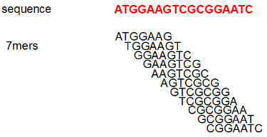
Hash table alignment
Note: K-mer is a short fixed sequence of nucleotides
First thing: “wrap up” the reference genome to bring it to the reads – build a kmer hash
Scan the reference genome:
Build a profile (index) of all possible k-mers of length n
and the locations in the reference genome they occur:
Hash table will be several Gbytes in size for human genome
Notes:
The first fast method is a hash-table. This is a sketch of how it works.
A typical algorithm will SCAN the REFERNCE GENOME base by base,
And record the kmer of length n starting at that base (e.g. 7mers)
It will PUT that kmer into a dictionary, along with a reference of where that kmer was found.
This is an example of the kmer-recording for 7-mers in this “genome”
Typical kmer hash for a mammalian genome is several Gb
THEN for each query sequence read, the algorithm will find the kmers in the read, look up the hash to work out where those kmers are in the gnome, and get an approximate best location of the read.
THEN it will do a careful Smith-waterman of the read in that approximate region to get the full alignment.
It turns out you can hash the genome and do the lookup with the reads (very large mem, but constant cost), or the other way around (lower mem, but variable cost)

Slide 19

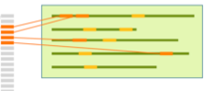

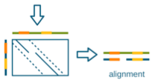
Hash table alignment
Start with the reference genome
Sequencing reads
Reference Genome
Kmer hash
Build a data structure (hash)
allows rapid lookup by kmer sequence.
Each kmer entry in the hash stores the genome location(s) the kmer came from.
Notes:
Here is another way of saying the same thing:
On the right is the reference genome.
You scan through it building up a kmer-hash
The hash you build has an entry for every distinct kmer, AND points back at the locations the kmer was found
AND IT CAN BE HUGE IN SIZE
Key point: it’s a way of packaging up the reference genome and bringing the information to the query sequences

Slide 20
Hash table alignment
Note: K-mer is a short fixed sequence of nucleotides
First thing: “wrap up” the reference genome to bring it to the reads – build a kmer hash
Scan the reference genome:
Build a profile (index) of all possible k-mers of length n
and the locations in the reference genome they occur:
Hash table will be several Gbytes in size for human genome
Next: For each sequence read:
Split the read into k-mers of length n
Lookup the locations in the reference via the index hash table you just made
Your hash table stores genomic locations => Pick region on the genome with most k-mer hits
Perform Smith-Waterman alignment to fully align the read to the region
Output the alignment of each read onto the reference in BAM (or equivalent) format.
Notes:
The first fast method is a hash-table. This is a sketch of how it works.
A typical algorithm will SCAN the REFERNCE GENOME base by base,
And record the kmer of length n starting at that base (e.g. 7mers)
It will PUT that kmer into a dictionary, along with a reference of where that kmer was found.
This is an example of the kmer-recording for 7-mers in this “genome”
Typical kmer hash for a mammalian genome is several Gb
THEN for each query sequence read, the algorithm will find the kmers in the read, look up the hash to work out where those kmers are in the gnome, and get an approximate best location of the read.
THEN it will do a careful Smith-waterman of the read in that approximate region to get the full alignment.
It turns out you can hash the genome and do the lookup with the reads (very large mem, but constant cost), or the other way around (lower mem, but variable cost)

Slide 21
Hash table alignment
Sequencing reads
Kmer hash
Reference Genome
read
read
Notes:
Similarily, we can find those kmers in the reads and consequently, we can begin to map these reads to locations on the genome.
Note how with 2 kmers (or generally more) from the same read ,
we can try and identify where these two kmers cluster (to same approx location) in the genome
Of the many possibilities, find a best approximation

Slide 22
Hash table alignment
Sequencing reads
Kmer hash
Reference Genome
read
read
Notes:
We can then carefully align the original read and the best approximation (the “extend” bit) using SW to get an optimal alignment

Slide 23
Hash table alignment
Note: K-mer is a short fixed sequence of nucleotides
First thing: “wrap up” the reference genome to bring it to the reads – build a kmer hash
Scan the reference genome:
Build a profile (index) of all possible k-mers of length n
and the locations in the reference genome they occur:
Hash table will be several Gbytes in size for human genome
Next: For each sequence read:
Split the read into k-mers of length n
Lookup the locations in the reference via the index (seed phase)
Pick region on the genome with most k-mer hits
Perform Smith-Waterman alignment to fully align the read to the region
Output the alignment of each read onto the reference in BAM (or equivalent) format.
Hash of the reads: MAQ, ELAND, ZOOM and SHRiMP
Smaller but more variable memory requirements
Hash the reference: SOAP, BFAST and MOSAIK
Advantage: constant memory cost
Notes:
The first fast method is a hash-table. This is a sketch of how it works.
A typical algorithm will SCAN the REFERNCE GENOME base by base,
And record the kmer of length n starting at that base (e.g. 7mers)
It will PUT that kmer into a dictionary, along with a reference of where that kmer was found.
This is an example of the kmer-recording for 7-mers in this “genome”
Typical kmer hash for a mammalian genome is several Gb
THEN for each query sequence read, the algorithm will find the kmers in the read, look up the hash to work out where those kmers are in the gnome, and get an approximate best location of the read.
THEN it will do a careful Smith-waterman of the read in that approximate region to get the full alignment.
It turns out you can hash the genome and do the lookup with the reads (very large mem, but constant cost), or the other way around (lower mem, but variable cost)

Slide 24
Wrapping up the genome and bringing it to your reads
wrap up
GENOME
Kmer-hash
Rapid lookup
Reads
Suffix trie
…Suffix tree
…FM index
Rapid lookup
Notes:
So we have seen one method of summarising the genome and bringing it to the reads, and seen how it facilitates rapid lookup / alignment, at the cost of lots fo extra data structures.
The second main aligner method is the suffix tree method: it is another way of summarising the genome so that you can do rapid lookups for reads (followed by careful local alignments)

Slide 25
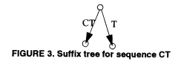
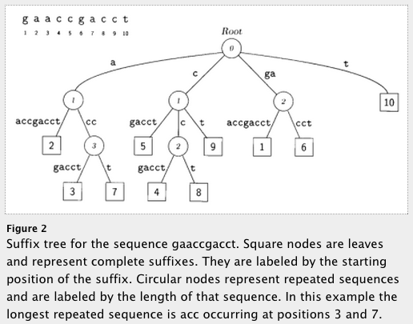
Suffix/Prefix tree based aligners
For fast string matching: A suffix trie, or simply a trie, is a data structure that stores all the suffixes of a string, enabling fast string matching.
Build a suffix-trie for the genome:
- a different structure to bring the genome to the query
- But the memory requirements are huge
More terms: BW transform, FM-index …
- Methods of reducing memory & time footprint
Examples: BWA, bowtie2, MUMMer
Genome
Trie based on genome
(slightly compacted)
Delcher et al (1999) NAR
Notes:
Suffix trie (pronounced “try”) is a data structure which allows the whole genome to be indexed: this is a different way of bringing the wrapped-up genome to your query sequences.
Here are a couple of examples of suffix tries – the first one is for a sequence of two characters, the first last letter (T) and then the next suffice CT, and build a second branch.
Similarly, if your whole genome consisted of “GAACCG…T” then you’d first build a path from the last letter (T), and then CT, the CCT etc. The number in the square is the start position of the suffix.
The resulting structure is a compact way of storing a wrapped up genome, along with locations where the subsequences were drawn from.
SO you can walk up to this structure with a read (a short pattern), and chase down the paths that match your pattern, and read off the matching substrings and their positions, since the tree LEAVES store the ending positions of the suffixes. SO you recover where there was a match + position of the match. This can be shown to be QUICKER than other methods.
The storage cost of the tree is enormous, so the GENOME is first subject to a BW transform / FM index to make it compact:
THEN the trie is built.
And the transition from the original trie to the BW-transformed suffix array is beyond the scope of this talk.
EXAMPLES of aligners which use suffix trees and BW indices include the big two (BWA and BOWTIE2)

Slide 26
Mapping qualities
What if there are several possible places in the genome to align your sequencing read?
Genomes contain many different types of repeated sequences
Transposable elements (40-50% of vertebrate genomes)
Low complexity sequence
Reference errors and gaps
Plenty of closely paralogous genes!
The aligner will issue a MAPPING QUALITY to each alignment
Mapping quality is a measure of how confident the aligner is that the read is corresponds to this location in the reference genome
Typically represented as a phred score (log scale)
Q0 = read placed with identical score elsewhere
Q10 = 1 in 10 probability of being incorrect
Q20 = 1 in 100 probability of being incorrect
Paired-end sequencing is useful - if one end maps inside a repetitive elements and one outside in unique sequence: the the aligner will use this
Hence prefer paired-end sequencing
Notes:
Walkthrough points above.

Slide 27
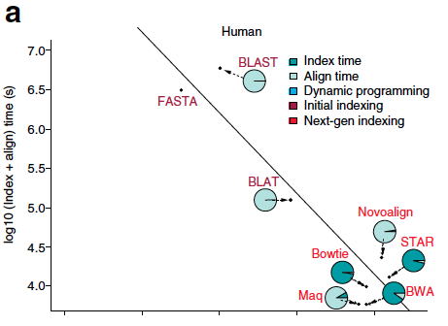
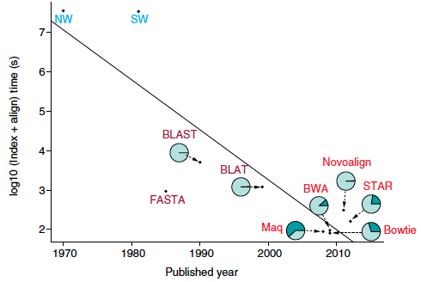
Aligner choice – some considerations
Align times are dropping exponentially by year (roughly Moore’s law)
Yeast is quicker than human.
Dynamic programming (NW) is slow cf hashing (BLAT) is slow compared to suffix trie (BWA)
Human
1 million SE 75bp reads
Yeast
Muir et al. Genome Biology (2016)
DOI 10.1186/s13059-016-0917-0
Notes:
There are LOADS of aligners out there:
And for fun, here is “MOORES LAW” for aligners when run on simulations:
you can see that in log space the like-for-like index + align time for 1m reads is falling linearly by the year.
Note the graphs: NW = Needlman Wunsch, SW = smith waterman.
Top graph = Human, Bottom graph = yeast. The times for human are (not surprisingly) slower by 100 = 2 on log scale
Look at the human cluster: everything seems to align 1m reads in about 10^4 seconds = 10,000 seconds
So there’s not much actual difference in the align times by aligner.
WHEN WE DO THE PRACTICAL: keep this number in mind and see if you can compare?
Number: 1m reads = 10,000 seconds = 2.7 hours.
When we do the practical we will align 300,000 reads in about 5 minutes.
So we’d expect to process 1m reads in about 15 minutes = 1000 seconds.
So the graphs are off by a factor of 10. Note: some time for indexing included.

Slide 28
Aligner choice – some considerations
In the event that you have a choice of aligner to use
Read manual, publication, vignette, etc
Align times are dropping exponentially by year (roughly Moore’s law)
Yeast is quicker than human.
Dynamic programming (NW) is slow cf hashing (BLAT) is slow compared to suffix trie (BWA)
Sometimes, defaults may not be appropriate for your study
Does an aligner/mapper support:
my platform (Illumina, PacBio etc)?
my sequence type (DNA, RNA, etc)?
paired end reads?
my read lengths (e.g. PACBio are long 10’s of thousands)
Human
1 million SE 75bp reads
Consider speed, and memory requirements and your resources
Does it allow for mismatches (SNPs)? (Configurable)
Support for gapped alignments? (Yes)
How does it handle multi-mapping reads? (Configurable)
Does it allow spliced alignment (RNA seq)? (Purpose built aligners for this)
Yeast
Muir et al. Genome Biology (2016)
DOI 10.1186/s13059-016-0917-0
Notes:
There are LOADS of aligners out there, and if / when you are choosing one, you should ask the following questions –
Quite generally you should read the manual / user guide – the default may not be appropriate for you!

Slide 29
Some alignment options (there are lots more)
Aligner | Gapped alignment | SE and/or PE | Input format | Output format | Trimming? | BS-seq | Note
BWA-MEM | Yes | SE, PE | FASTQ FASTA | SAM | No | No | Seed + extend: Local alignment
Bowtie | No | SE, PE | FASTQ FASTA | SAM | Yes | No | Mismatches <=3
Bowtie2 | Yes | SE, PE | FASTQ FASTA qseq | SAM | Yes | No | Seed + extend: Local alignment
TopHat | Yes | SE, PE | FASTQ FASTA qseq | SAM | Yes | No | Uses bowtie or bowtie2 as base aligner
STAR | Yes | SE, PE | FASTQ FASTA | SAM | Yes | No | Fastest and most accurate for RNAseq
careful
Unspliced:
No intron-sized gaps
Don’t use old tech
Spliced aligns
(RNASeq)
Spliced:
Allow for big gaps inside reads, are aware of gene-structure
Independently performs spliced aligns (no preprocessing)
Notes:
Here I’ve written two current aligners and two splice-aware aligners.
Moral – this table actually looks remarkably uniform, once you account for specific function:
It’s possible that your team / institute etc will make choices based on FUNCTION. Do you need spliced alignment?

Slide 30
Alignments – scaling up
Question:
IF: 50Mbp bwa mem = 5 CPU minutes.
AND: 1 human genome sequenced at 45x = 150 Gbp per HiSeqX10 lane
THEN: How long will it take to align your 45x human genome sequencing?

Slide 31
Alignments – scaling up
Question:
IF: 50Mbp bwa mem = 5 CPU minutes.
AND: 1 human genome sequenced at 45x = 150 Gbp per HiSeqX10 lane
THEN: How long will it take to align your 45x human genome sequencing?
ANSWER:
How many lots of 50Mb in 150Gb ?
150Gb / 50Mb = (150 x 10^9) / (50 x 10^6) = 3 x 10^3 lots
Each lot takes 5 minutes => total time is 5 x 3 x 10^3 CPU minutes
15000 CPU minutes = 250 hours ~ 10 days ouch.

Slide 32
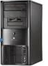
Alignments – scaling up
This is why we like compute clusters!
AS ALWAYS: The strategy is to:
Chop up the problem into small pieces and
Solve each piece in parallel, with N computers working at same time
Put the pieces back together after.
RESULT: Time of problem is reduced by N.
@read1
ACGTANATCN
+
$$%SSG$%££@
@read2
AGCNTNCTCA
+
£$$%£$%%^&
Full file.fastq
Full file.fastq
@read1
ACGTANATCN
+
$$%SSG$%££@
@read2
AGCNTNCTCA
+
£$$%£$%%^&
Piece2.fastq
…
PieceN.fastq
Piece1.fastq
N Computers
Piece1.bam
…
PieceN.bam
Full File.BAM
Full File. BAM
Notes:
You know that the most common sequence format prior to alignment is FASTQ.
So, naively, if we had 150Gbp of fastq, we could throw it at a single computer and wait for 10 days.
Instead, we ALWAYS do the following:
Chop the problem into small pieces by chopping up the fastq
Align each piece on a separate computer
Stitch the pieces together afterwards.

Slide 33
Alignments – scaling up
Question:
IF: 50Mbp bwa mem = 5 CPU minutes.
AND: 1 human genome sequenced at 45x = 150 Gbp per HiSeqX10 lane
THEN: How long will it take to align your 45x human genome sequencing?
ANSWER:
How many lots of 50Mb in 100Gb ?
150Gb / 50Mb = (150 x 10^9) / (50 x 10^6) = 3 x 10^3
Each lot takes 5 minutes => total time is 5 x 3 x 10^3 CPU minutes
15000 CPU minutes = 250 hours ~ 10 days ouch.
Compute Cluster with N nodes: Time of problem is reduced by N.
E.g. if you have dedicated 200 nodes, the time for alignment drops to ~ 1.25 hrs
- Which is ok for a single sample.
- If you have 1000 samples, you need more nodes + better optimisation.
- At WTSI, alignment is more much more efficient (dedicated resources)

Slide 34
Overview
Intro
Methods / Aligners
Alignment Outputs
Alignment Viewers
NGS Workflows, QC and BAM Improvement
Notes:
We want to start viewing alignments!
But first we will have a brief review of alignment formats

Slide 35
LET’S HAVE A BREAK

Slide 36
Overview
Intro
Methods / Aligners
Alignment Outputs
Alignment Viewers
NGS Workflows, QC and BAM Improvement
Notes:
We want to start viewing alignments!
But first we will have a brief review of alignment formats

Slide 37

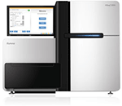
Pre-alignment file formats
Data generation
The same 4 line format for paired reads (PE sequencing)
FASTQ
Read ID
Read sequence
@IL16_4408:3:5:17860:13258
CTGGCTCACATACAGGCCAGTATAAAGCGTCTCCTTTAAA
+
HHHHHHHHHHHHHHHHHHHHHHHHHHHHHHHHHHHHHHHE
@IL16_4408:3:14:13276:1210
GTAGAAAACAATATAGAAGCCTTAGGACAGAAAACCCTAA
+
HHHHHHHHHHHHHHHHHDHHHHHHHHBGHHHHHHCDCCF>
@IL16_4408:3:83:5210:21157
AGGCAGCAGGAACTCCAGTTAGGCCATAGTTCATCCTTGC
Read ID
@IL16_4408:3:5:17860:13258
CAGTTTTTTCAGAGCAGTAGCCATTAGGCACAATGTGATT
+
FFFFFFFFFFFFFFFFFFFFFFFFFFFFFFFFAFFBFFFF
@IL16_4408:3:14:13276:1210
AGTCAACAGATGTCCTTTGAGCTTAAGAATTCAGCAGAAG
+
FFFFFFFFFFFFFFFFFFFDFFFFFFFFFFFFFFFFFDCF
@IL16_4408:3:83:5210:21157
GGGCCAGTGTGTCCCCTCCTGCCACTGAAGACCATGCTAT
Qualities
Notes:
When a sequencer runs, we will be handed FASTQ.
You’ve seen this already, so call out the lines!
How many lines per seq read?
What do they represent?
How is paired-end sequencing represented? With TWO files, with the two reads in each pair occurring in the SAME order in each file.
YOU’VE ALREADY COME ACROSS FASTQ today.
This is the standard pre-alignment file format, with 4 lines per seq:
Seq name
Sequence
+ and optional seq name
Coded quality.
You will see that for paired-end, there are two files, with the second file containing mate-pairs, in the same order as the original file.

Slide 38

Post-alignment file formats
SAM (Sequence Alignment/Map) format
Single unified format for storing read alignments to a reference genome
Developed by the 1000 Genomes group in 2009
BAM (Binary Alignment/Map) format
Binary equivalent of SAM
Developed for fast processing/indexing
Block GZIP compression for random access of regions
Key features
Can store alignments from most aligners
Supports multiple sequencing technologies
Supports indexing for quick retrieval/viewing
Compact size (e.g. 112Gbp Illumina = 116Gbytes disk space)
Reads can be grouped into logical groups e.g. lanes, libraries, samples
Widely support by variant calling software packages
Specification maintained by the Global Alliance for Genomics and Health
Notes:
Once reads have been aligned, they are almost always stored as BAM, which is a compressed (binary) equivalent of SAM.
SAM – was created by the 1000genomes group
BAM – efficient method of storing the same format.
Basically universal format, and it’s key features:

Slide 39
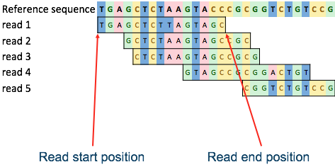
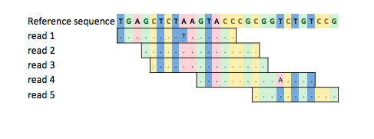
Reference based compression
BAM stores all of the data
Every read base
Every base quality
Using a single conventional compression technique for all types of data
CRAM: Important concepts
Reference based compression
Controlled loss of quality information
Different compression methods to suit the type of data, e.g. base qualities vs. meta-data vs. extra tags
Notes:
BUT we’re not done yet:
It turns out that most of the read will be redundant, because it is the same as the reference sequence.
In that case, you can achieve better compression, by referring to the reference instead of storing this redundant information.
And, if you are prepared to lose some fine-grained quality info, you can save more space, and that’s the purpose of cram.

Slide 40
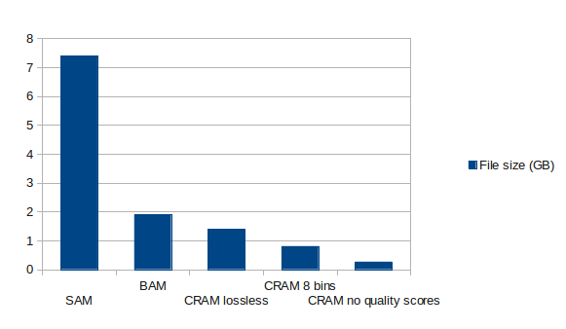
CRAM format
WHY CRAM?
BAM files are too large
~1.5-2 bytes per base pair
Increases in disk capacity are being far outstripped by sequencing technologies
CRAM:
Widely seen as the sequencing format of the future
Many popular tools now support CRAM
Samtools, Picard, Bedtools (in the future)
Closer to here now
Sanger stores everything as lossless cram
Notes:
There is a POINT to doing this compression – data volume has gotten too large to ignore even modest reductions in file size
This shows the relative sizes of SAM vs BAM vs CRAM (though the red arrow shows current CRAM efficiency)
and it also shows what we _could_ achieve if we were prepared to lose exact quality scores on each base.
NOTE: Sanger stores everything in its archives as lossless CRAM!

Slide 41
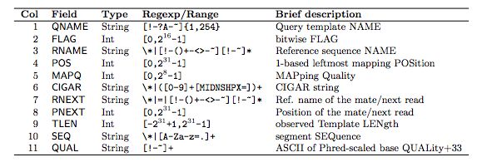
SAM/BAM format
SAM fields
CIGAR string
Cigar has been traditionally used as a compact way to represent a sequence alignment: to go “FROM one string TO another you perform these operations”.
Operations include
M - match or mismatch
I - insertion
D - deletion
S - soft clip (ignore these bases)
H - hard clip (ignore and remove these bases)
E.g.Read: ACGCA-TGCAGTtagacgt
Ref: ACTCAGTG--GT
Cigar: 5M 1D 2M 2I 2M 7S
Notes:
IN PRACTICE, this is what we see when we stare at a bam file.
The key point is the RNAME, POS field.
We will be staring a lot at SAM in a moment, but for reference, here are the actual fields from the spec.
The meat of the alignment is the sequence name (QNAME), chromosome (RNAME) and position (POS).
CIGAR:
How well did the read actually match the refernce at the position ? That’s the content of the CIGAR string:
It will describe an operation: M, I, D etc which you apply to the read to get it to match the reference.
Here is an example:
FLAG: The read itself has a lot of properties arise from the alignment:
Is its mate-pair mapped sensibly?
Did it get split up during alignment, and is the ‘smaller part?’
Is it READ1 or READ2?
- This kind of info is stored up in the FLAG field, and you can query for what particular FLAG values mean using “samtools flag “ command

Slide 42
INTERLUDE – PAIRED END SEQUENCING PARAMETERS
Notes:
The effect of compression on a SAM (not compressed) using BAM, lossless CRAM and lossy CRAM.
Format of the future. Many NGS pipelines now adopting CRAM for long term storage (less storage required).
CRAM lossless is better now than shown here

Slide 43
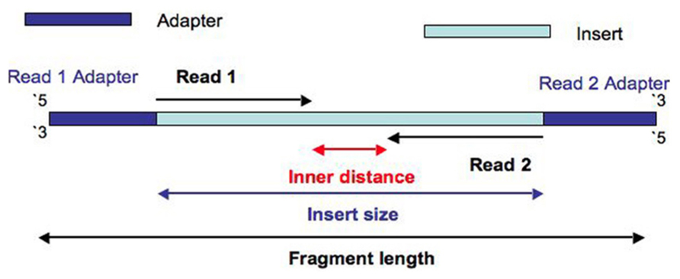
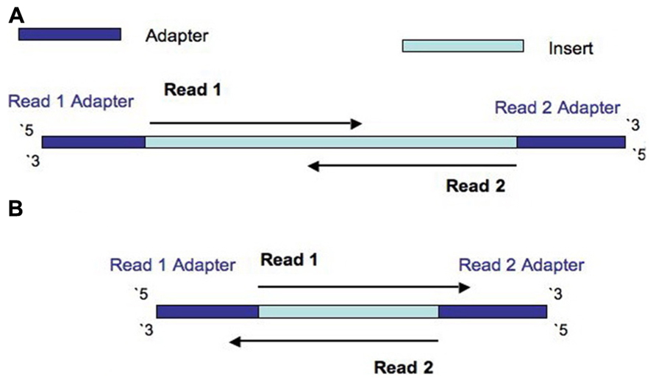
Fragment length, insert size and inner mate distance
Insert size > length(read 1 + read 2)
Insert size < length(read 1 + read 2)
Insert size < length(read 1); Insert size < length(read 2)
Turner, 2014. PMID:24523726
Notes:
Much of WGS and WES is paired-end sequencing, meaning that
the genome is sheared into fragments,
sequencing adapters added to the end of each fragment,
And then TWO sequencing reads are created, reading in from the adaptors.
That straight away gives you these parameters that you can read off once the alignment is done:
Insert size
Inner distance
Note – I’ve put up three possible situations that could occur, depending on how large the fragment is compared to the read length:
ALL is well, and the insert size is larger than combined read-length
The reads overlap because the insert size is too small. This is bad. Why?
Reads actually overrun the insert and read into the opposite sequencing adaptor.
I am pointing this out because shortly we will be viewing read pairs! We will probably not see overlapping reads, BUT we will be seeing unexpectedly large inserts, in the context of large deletions.

Slide 44
Fragment length, insert size and inner mate distance
Insert size > length(read 1 + read 2)
Both reads get the same “name”
Insert size < length(read 1 + read 2)
Insert size < length(read 1); Insert size < length(read 2)
Turner, 2014. PMID:24523726
Notes:
Much of WGS and WES is paired-end sequencing, meaning that
the genome is sheared into fragments,
sequencing adapters added to the end of each fragment,
And then TWO sequencing reads are created, reading in from the adaptors.
That straight away gives you these parameters that you can read off once the alignment is done:
Insert size
Inner distance
Note – I’ve put up three possible situations that could occur, depending on how large the fragment is compared to the read length:
ALL is well, and the insert size is larger than combined read-length
The reads overlap because the insert size is too small. This is bad. Why?
Reads actually overrun the insert and read into the opposite sequencing adaptor.
I am pointing this out because shortly we will be viewing read pairs! We will probably not see overlapping reads, BUT we will be seeing unexpectedly large inserts, in the context of large deletions.

Slide 45
NOW WE RESUME OUR NORMAL PROGRAMMING
Notes:
The effect of compression on a SAM (not compressed) using BAM, lossless CRAM and lossy CRAM.
Format of the future. Many NGS pipelines now adopting CRAM for long term storage (less storage required).
CRAM lossless is better now than shown here

Slide 46
SAM/BAM/CRAM format in practice
HX8_24050:5:2103:20770:9449 83 7 4189207 0 151M = 4188954 -404 GTTG <JJJ MC:Z:151M MD:Z:151 NM:i:0 AS:i:151 XS:i:151
…
HX8_24050:5:2103:20770:9449 163 7 4188954 0 151M = 4189207 404 TTGG AAFF MC:Z:151M MD:Z:151 NM:i:0 AS:i:151 XS:i:151
HX8_24050:3:2212:32319:38772 99 7 4188947 0 151M = 4189300 436 ATGG AAAF MC:Z:68S83M MD:Z:151 NM:i:0 AS:i:151 XS:i:151
…
HX8_24050:3:2212:32319:38772 147 7 4189300 0 68S83M = 4188947 -436 ACAG --7- MC:Z:151M MD:Z:5C10T4T61 NM:i:3 AS:i:68 XS:i:75
QNAME: read id
- matches fastq
SEQuence
QUALity (alignment doesn’t use them, but variant callers will)
FLAG:
> samtools flags 83: PAIRED, PROPER_PAIR, REVERSE, READ1
> samtools flags 163: PAIRED, PROPER_PAIR, MREVERSE, READ2
RNAME, POS – chromosome & base pair position
ALIGNMENT TAGS:
http://www.samformat.info/sam-format-alignment-tags
MC:mate cigar
MD:string for mismatching positions
NM:Edit distance to the reference (no clipping)
AS:Aligner’s Alignment score
XS:suboptimal alignment score (aha!!)
MAPQ mapping quality
CIGAR M? S? I ? D ?
RNEXT, PNEXT - paired read chr & position
RNEXT “=“ means same as first read
PNEXT: read2 aligns 5’ of read1.
TLEN: insert size
Notes:
Step through each field one by one, so in exercises it becomes automatic.
Qname = fastq match (up to pair)
FLAG: how can they find out what this means? Samtools flags – try it at exercise.
Need to be able to read/understand this.
Read could be in a pair, unpaired, in the wrong orientation etc
MORE importantly, it could be a PCR dup (marked as such) or machine fail. You can samtools view and remove such reads deliberately.
RNAME POS, the important stuff: where the 5’ end of the read starts
MAPQ, CIGAR. MAPQ is an indication of how confident the aligner is that this is the best hit. We have zeros here – what does that mean?
CIGAR – step through the meaning of 151M and 68S83M
RNEXT PNEXT – point at position of the second element of a pair
TLEN: PCR template minus the adapter edges: difference in read-POS + length of a single read (have to do it this way because the POS is always the 5’ end)
SEQ, QUALITY – will discuss map quality shortly, and mappability.
ALIGNMENT TAGS. Look at the SAM spec, but also this cool website.
https://broadinstitute.github.io/picard/explain-flags.html
Some aligners put their own specific tags in here, but these are look-upable from the website.
Look at the NM tag, note the mark of the mismatches in the MD field corresponds to the NM:3 tag, but also that it’s indicating mismatches outside the clipping
Note the AS / XS tag: for a MAPQ=0 read, why do you expect XS to be the same as AS ?

Slide 47
SAM/BAM/CRAM format in practice
HX8_24050:5:1217:22455 83 7 87483848 60 118M1I32M = 87483669 -329 TG.. FJ.. MC:Z:151M MD:Z:150 NM:i:1 AS:i:143 XS:i:0
QNAME:
FLAG
RNAME POS
MAPQ
CIGAR
RNEXT, PNEXT
RNEXT
PNEXT
TLEN: can we work this out from the POS and PNEXT?
SEQ: QUAL:
MC: how does the mate match?
MD: Does the mate have a mismatch?
NM: This read: what is the edit distance?
AS: what the current alignment score?
XS: what is the align score of the next-best-hit?
Notes:
Now interpret a new read, note differences:
MAPQ=60 – is that good? What extended sam alignment tags could we relate to this?
Note the MQ = 60 now, not zero. Also you could sort-of-infer this from the AS field (143) and the XS field – the next-best hit is NOT unique. So my guess is 60 is the best MAPQ you can get.
CIGAR string, what does that mean? There is a 1bp INSERTION in addition to the match
Insert size = 329:
TLEN : 3848 – 3669 = 179, Plus 150 for read => 329,tip-to-tail. Note that the IMD is only 29bp, but that’s ok.
The ID is 29, which is small (IS is on the small end of the distribution)

Slide 48
Overview
Intro
Methods / Aligners
Alignment Outputs
Alignment Viewers
NGS Workflows, QC and BAM Improvement

Slide 49
Three viewers, in order of sophistication
Context:
You have a mouse.
You extracted DNA from mouse kidney and performed paired-end Whole-Genome Sequencing.
Core sequencing facility (and/or an informatician and / or you) produces the alignments and summary stats.
They do variant calling! You find some variants you like, or some differentially expressed genes.
YOU HAVE TO LOOK AT YOUR ALIGNMENTS.
You will need:
Genome file (ie the reference)
Genome file: GRCm38.fa. Remember, there’s always a reference back there …
Gene annotations.
Alignment file: MySample.bam
Moral
… You need to have a look at it. You cannot just trust a spreadsheet of variants given to you by someone else.
Notes:
When do you need to look at alignments?
Normally we do this along the way, but definitely when we get to the end of an analysis pipeline: looking at variants.
Typical story:
…
You will need.
Moral.

Slide 50
Viewer 1: samtools
You could just use samtools view at the command line.
- This shows you the bam header: chromosomes/contigs, read-groups, programs which have acted
This shows you each read id and CIGAR string, as well as mate structure (as we saw before)
$ samtools view –H MySample.bam
@HD VN:1.5 SO:coordinate
@SQ SN:1 LN:195471971 AS:GRCm38
@SQ SN:10 LN:130694993 AS:GRCm38
…
@SQ SN:X LN:171031299 AS:GRCm38
@SQ SN:Y LN:91744698 AS:GRCm38
…
@RG ID:332872 PL:ILLUMINA SM:MD5638a DS:WGS_ILLUMINA_short PU:24050_1
@RG ID:332873 PL:ILLUMINA SM:MD5638a DS:WGS_ILLUMINA_short PU:24050_2
…
@PG ID:basecalling_0 PN:Unknown PP:SCS_0 DS:Basecalling Package VN:Unknown
@PG ID:bambi_0 PN:bambi CL:/software/solexa/pkg/bambi/0.9.11/bin/bambi i2b ….
@PG ID:bamadapterfind_0 …
@PG ID:bwa_0 PN:bwa CL:/software/solexa/pkg/bwa/ ...
HX8_24050:4:2105:31456:16147 99 1 3000000 40 20M1I104M26S = 3000301 45 …

Slide 51
Viewer 1: samtools
You could just use samtools at the command line.
- This shows you the bam header.
This shows you each read id and CIGAR string, as well as mate structure.
But otherwise it’s a pretty poor way of visualizing anything.
No feel for relationship of pairs or how multiple reads show the same signal
The whole point of short-read sequencing is to infer variation etc from PILEUP – the cooperative action of lots of reads together, all having the same variation at the same point
Samtools doesn’t cut it.
HX8_24050:5:2103:20770:9449 83 7 4189207 0 151M = 4188954 -404 GTTG <JJJ MC:Z:151M MD:Z:151 NM:i:0 AS:i:151 XS:i:151
…
HX8_24050:5:2103:20770:9449 163 7 4188954 0 151M = 4189207 404 TTGG AAFF MC:Z:151M MD:Z:151 NM:i:0 AS:i:151 XS:i:151
HX8_24050:3:2212:32319:38772 99 7 4188947 0 151M = 4189300 436 ATGG AAAF MC:Z:68S83M MD:Z:151 NM:i:0 AS:i:151 XS:i:151
…
HX8_24050:3:2212:32319:38772 147 7 4189300 0 68S83M = 4188947 -436 ACAG --7- MC:Z:151M MD:Z:5C10T4T61 NM:i:3 AS:i:68 XS:i:75

Slide 52
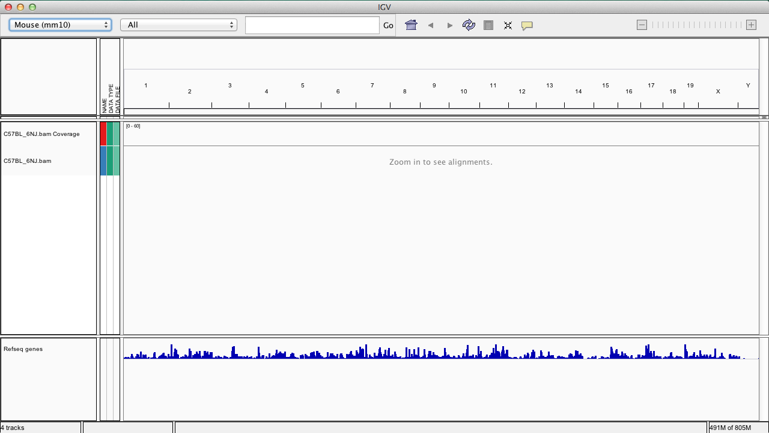
Option 3: Integrative Genomics Viewer (IGV)
Reference genome
Genome coordinates
Zoom in/out
Notes:
BUT we will use IGV in this class. When you bring this up, it will show you a pane like this.
Remember, you will need to provide
GENOME
ANNOTATIONS
And your bam file. Each bit slots into its own pane.

Slide 53
Integrative Genomics Viewer (IGV)
Reference genome
Genome coordinates
Zoom in/out
Coverage track
Sample track
Alignments view
Notes:
Then IGV also will add a COVERAGE track for you, which is a base-by-base readout of how many seq reads are on top of that particular base.
The reads / alignments themselves go in the middle.

Slide 54
Integrative Genomics Viewer (IGV)
Reference genome
Genome coordinates
Zoom in/out
Coverage track
Sample track
Alignments view
Annotated genes
Notes:
And there are annotated genes at the bottom.

Slide 55
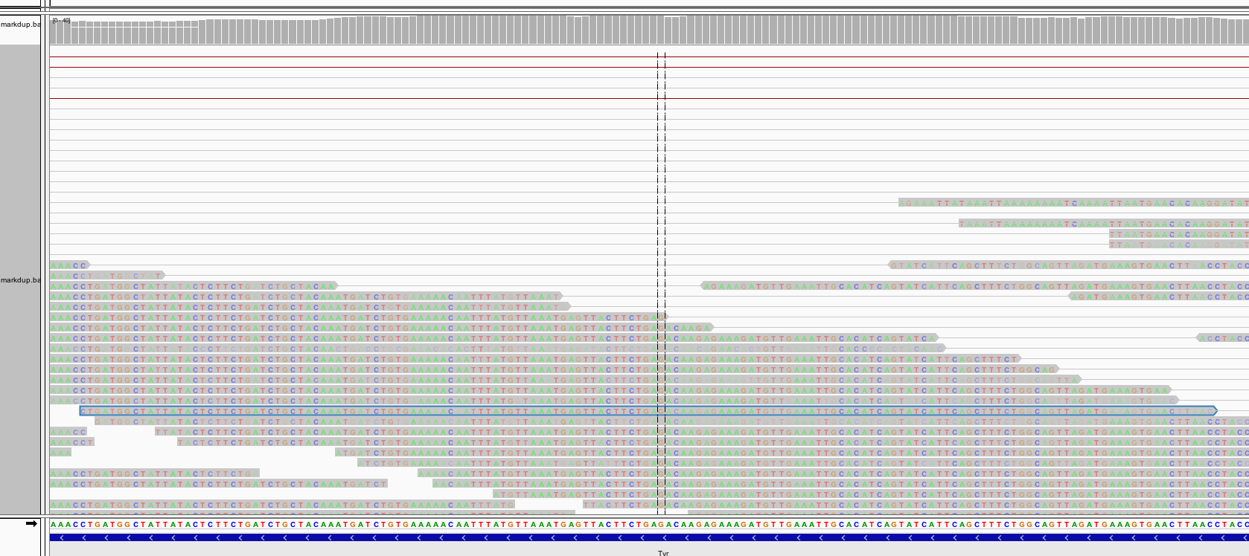
Integrative Genomics Viewer (IGV)
Coverage track
Alignments
Reference Genome
Gene annotations
samtools view shows this output: blue-outlined read is the first line
Notes:
This is typical of a view from IGV, deliberately made noisy.
Key points:
ALL ALIGNMENTS WITH RESPECT TO REFERENCE which YOU HAVE CHOSEN
Gene annotations along the bottom, which YOU HAVE CHOSEN – there are premade ones load-able by web, or from your files
Look at the SAMTOOLS VIEW output at the bottom.
The BLUE READ is drawn in its aligned position on the genome.
THAT is the first line of this SAM file.
But this is pretty noisy:
Look at the BASE sequence on the read:
if MATCHES reference then it’s pointless (and noisy) colouring the read with bases, so we remove the colouring for a match.

Slide 56
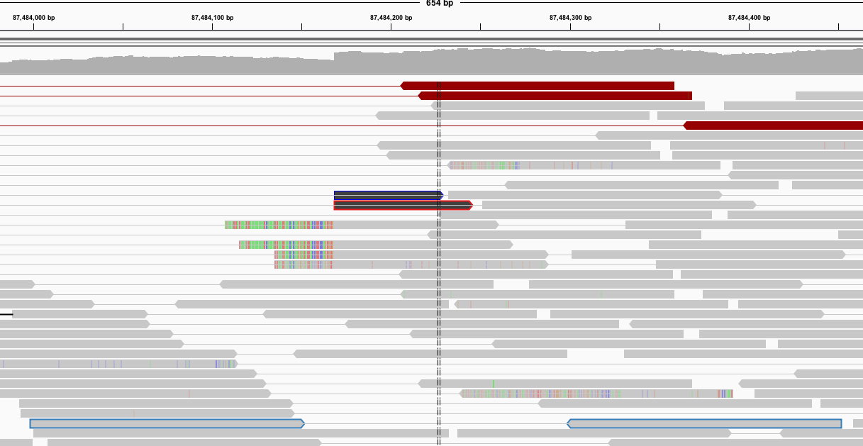
Integrative Genomics Viewer (IGV)
Coverage track
samtools view shows this output: blue-outlined reads are a pair
Notes:
READ PAIRS.
So we have switched off base-colouring when there’s a match, and we’ve zoomed out slightly. Our read is still there on the left.
Notice that most reads are pretty ‘grey’ which means that they just match the reference sequence.
Key points:
Look at the SAMTOOLS VIEW output at the bottom. You see two reads in a pair, insert size = TLEN 453bp (tail to tail distance), with CIGARS indicating no indels (no I, no D, no clipping)
And this is what IGV is showing in the blue outlined reads:
Look at the blue reads at the bottom. Notice they are GREY, indicating seq match at all points to the reference.
PAIR: Notice they have been joined by a line indicating they are part of a pair.
This pair is not interesting (unless the read-depth is interesting):
The interesting things happen when there is a DISCREPANCY between the reference and the sequence presented by the read.

Slide 57
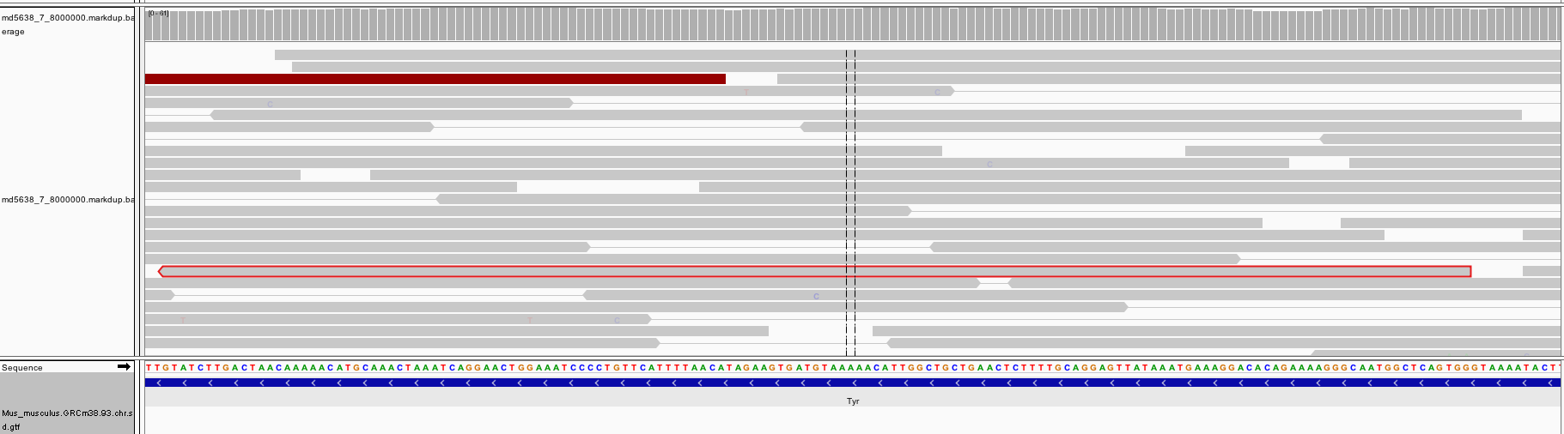
Integrative Genomics Viewer (IGV)
samtools view shows this output: red-outlined read is the 3’ read
Notes:
INTERESTING READS. Well, not this one.
This is one read of a pair of reads.
This is the 3’ read in the pair, you can see that it’s pointing “left”
Where’s the 5’ entry?

Slide 58
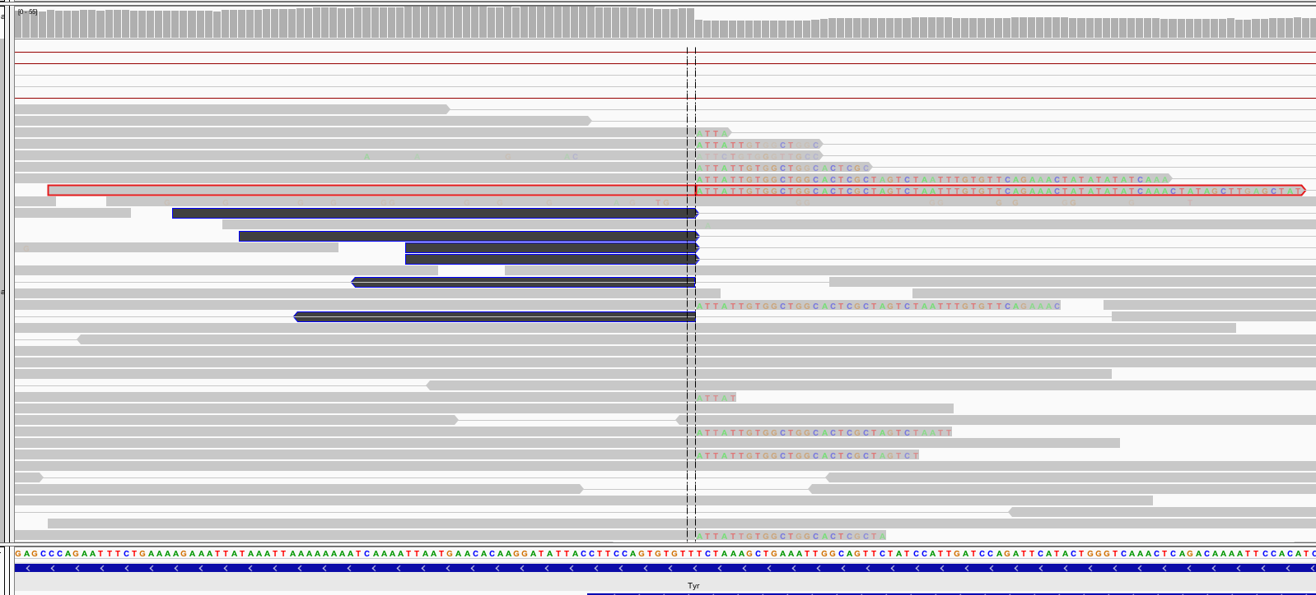
Integrative Genomics Viewer (IGV)
Coverage track
samtools view shows this output: red-outlined read is the 5’ read
Notice the CIGAR string is 78M 73S – softclipped means that the alignment STOPs at bp 78, but the rest of the read is NOT trimmed. Result is that EVERY BASE PAIR of the read will mismatch ref => bases are coloured!
Notes:
This is the 5’ read of that read pair. Now we have something interesting.
Specifcially, the LEFT part of the read aligns to the genome: that’s the grey bit corresponding to the 78M cigar string.
The RIGHT 73 bp of the read have not even been bothered to be aligned by the aligner: it’s basically given up, indicating that the alignment stops after 78 bp. Rather than cut off the rest of the sequence, it’s indicated that it will leave it, but it should be ignored (73S).
BUT our IGV doesn’t know that. It dutifully draws the read in, but notices that the bases are ALL MISMATCHING the reference from pos 70 onwards.
Hence the coloured text.

Slide 59
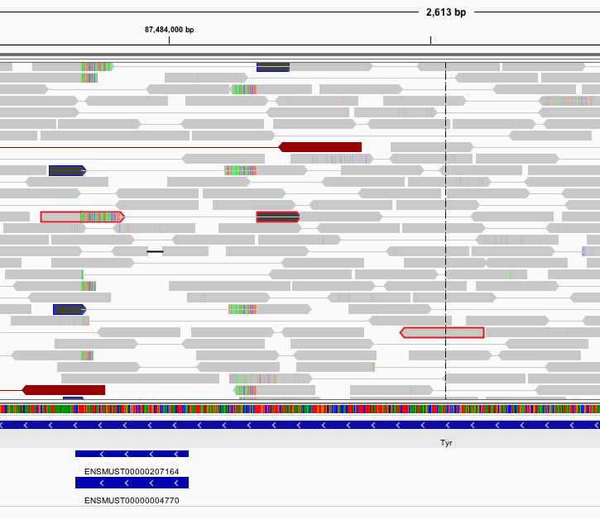
Integrative Genomics Viewer (IGV)
But wait! There’s more
samtools view will actually show three lines in the file with the same read name.
We have examined the left read (softclipped) and the right read (perfectly aligned).
The middle read alignment is the ‘right half’ of the left read. It is hard-clipped and marked as ‘secondary’ – see flags
Notes:
In fact, if you look carefully for all aligned locations of this read pair by zooming out, you will find THREE lines.
First line = aligned first half of read1 + softclipped second
Third line = Read 2, which is boring.
This is the usual read pair.
Second line = aligned second half of read1. Notice how the aligner has HARD CLIPPED the beginning of the read away and marked it ‘supplementary’
See red-outlined reads in the IGV which indicate all this.
Notice that it sort of messed up the read-pairing markup.

Slide 60
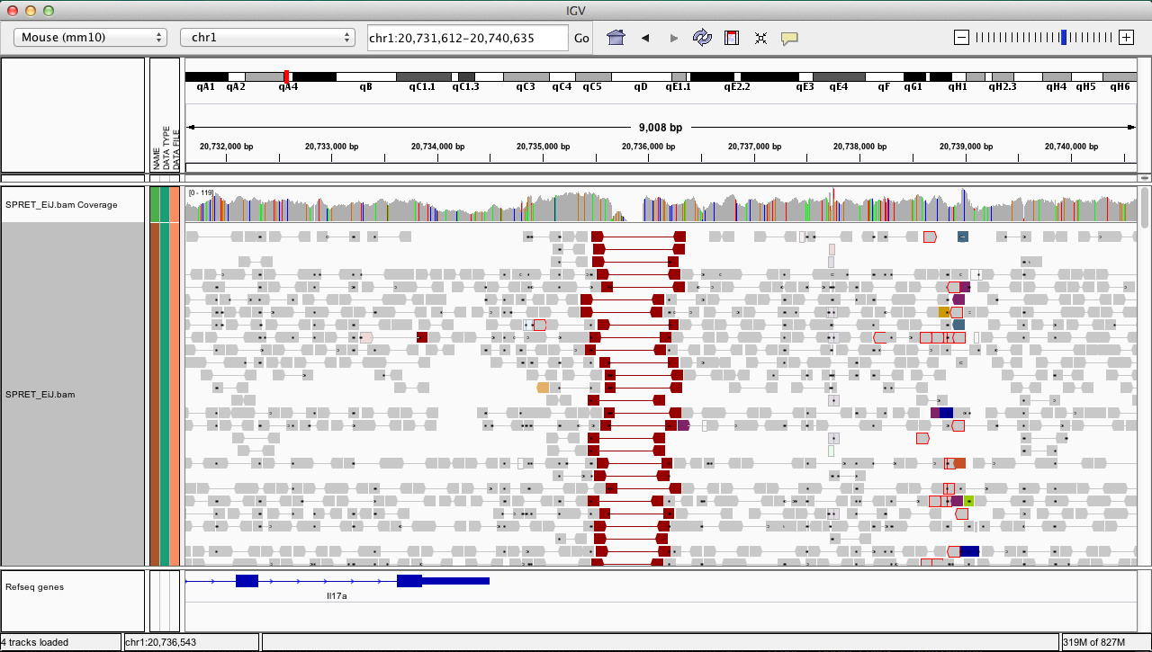
Viewing reads as pairs
Notes:
IT REALLY HELPS to VIEW READS AS PAIRS
If you zoom out slightly and view the reads as pairs, then you can see that there are pairs which span the deletion.
Why are the pairs coloured red?
Because in the actual sample genome they have a ‘normal’ distance apart, but when mapped to this reference genome they are separated by an unusually large insert size

Slide 61
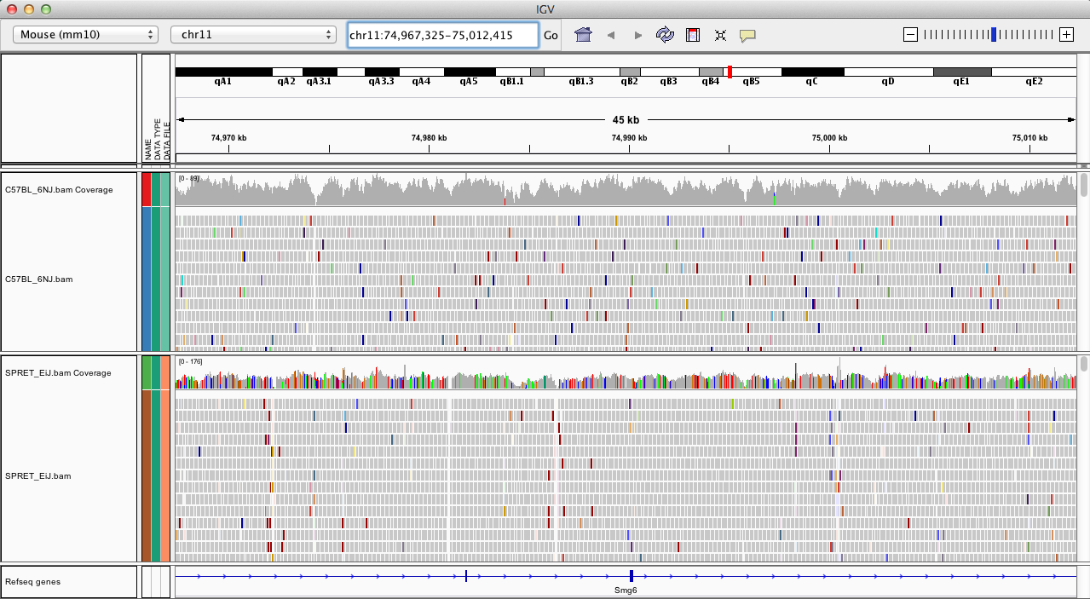
Two samples
Notes:
It’s worth pointing out that you can load in multiple sample tracks into IGV to compare effects in more than one sample at the same time

Slide 62
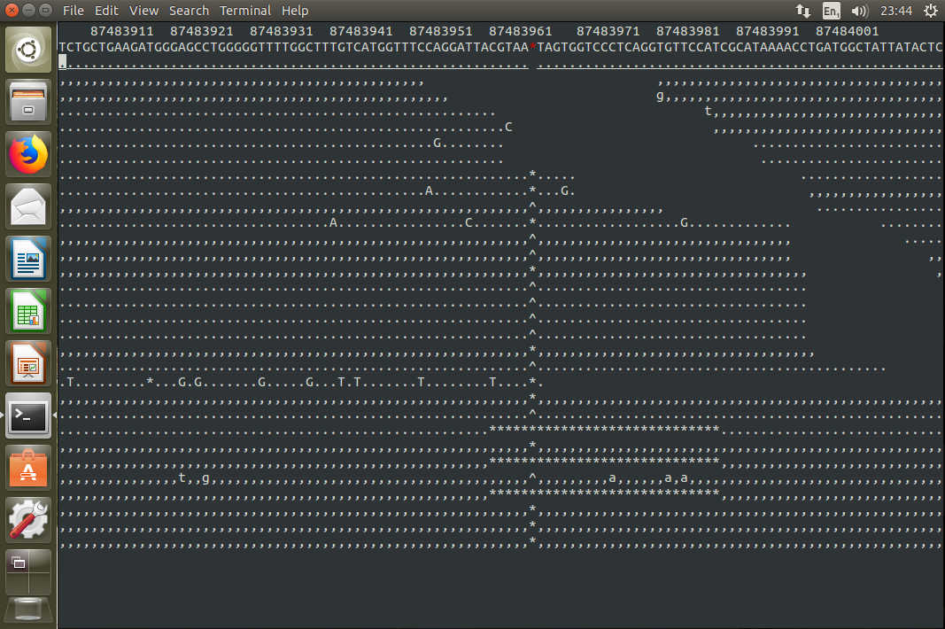
Option 2: samtools tview
If you were stuck on a desert island, this would do the job: and you can try it for fun during the practical!
﻿ samtools tview md5638.markdup.bam ../../ref/GRCm38.68.dna.toplevel.fa

Slide 63
Overview
Intro
Methods / Aligners
Alignment Outputs
Alignment Viewers
NGS Workflows, QC and BAM Improvement
Notes:
Next I’ll sketch out the actual workflows that alignments slot into in a production environment

Slide 64
LET’S HAVE A BREAK

Slide 65
Overview
Intro
Methods / Aligners
Alignment Outputs
Alignment Viewers
NGS Workflows, QC and BAM Improvement
Notes:
Next I’ll sketch out the actual workflows that alignments slot into in a production environment

Slide 66
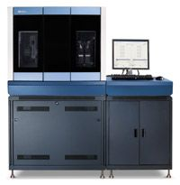
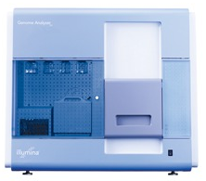
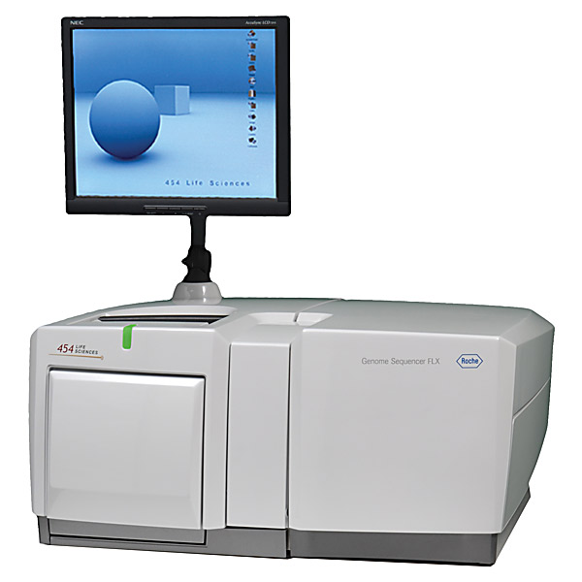
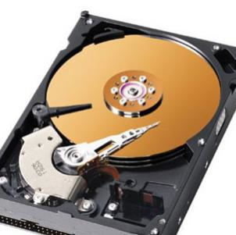

A typical NGS workflow
There might be
10’s, 100’s or
thousands of samples.
This needs a coordinated workflow:
Alignment is just one part
Sample/Platform
Sample
merge
NA34842
NA87465
Library
merge
BAM
BAM
BAM
Library
Freeze
BAM
BAM
BAM
……
BAM
BAM
BAM
Improvement
BAM
BAM
BAM
……
BAM
BAM
Alignment
(bwa, smalt, bowtie etc)
Fastq
Fastq
Fastq
……
Fastq
Fastq
Notes:
FIRST:
TYPICAL NGS EXPERMIENTS ARE DONE AT SCALE: there may be 100s of samples.
That needs a coordinated workflow, driven by planned software to bring it reliably together.
The alignment we were discussing is just the first part of that.

Slide 67
A typical NGS workflow
Typically in a production workflow:
One sample spread over multiple seq libraries.
One library spread over multiple seq runs (lanes)
Sample/Platform
Sample
merge
NA34842
NA87465
Library
merge
BAM
BAM
BAM
Library
Freeze
BAM
BAM
BAM
……
BAM
BAM
BAM
Improvement
BAM
BAM
BAM
……
BAM
BAM
Alignment
(bwa, smalt, bowtie etc)
Fastq
Fastq
Fastq
……
Fastq
Fastq
Notes:
Moreover, in that workflow,
A sequencing plan might:
Split a sample across multiple libraries – this happens sometimes
And split a library across multiple lanes - that happens A LOT.
WHY?

Slide 68
Data production workflow
Typically in a production workflow:
One sample spread over multiple seq libraries.
One library spread over multiple seq runs (lanes)
Sample/Platform
Sample
merge
NA34842
NA87465
Library
merge
BAM
BAM
BAM
Library
Freeze
BAM
BAM
BAM
……
BAM
BAM
BAM
Improvement
BAM
BAM
BAM
……
BAM
BAM
Alignment
(bwa, smalt, bowtie etc)
Fastq
Fastq
Fastq
……
Fastq
Fastq
WHY?

Slide 69
Data production workflow
Typically in a production workflow:
One sample spread over multiple seq libraries.
One library spread over multiple seq runs (lanes)
Sample/Platform
Sample
merge
NA34842
NA87465
Library
merge
BAM
BAM
BAM
Library
Freeze
BAM
BAM
BAM
……
BAM
BAM
BAM
Improvement
BAM
BAM
BAM
……
BAM
BAM
Alignment
(bwa, smalt, bowtie etc)
Fastq
Fastq
Fastq
……
Fastq
Fastq
Mitigation of batch (run/instrument) effects
Split library over multiple lanes
- Increasing sequencing depth (more libraries)
Notes:
The split of a library across multiple runs is to mitigate batch effects:
Say you have four samples:
If you process first sample in one run and your second sample in a second run etc, then you are open to
losing your second sample if your run fails
Having pronounced difference in read-depth if there’s a difference between runs, or any other systematic effect that your QC would flag up.
Split ALL of your samples across four runs (say) and the variability in one run is smeared across all your samples.
Secondly, you may have to increase the number of runs for a specific sample to increase the read-depth (seq volume),
SO you have to prepare multiple libraries.

Slide 70
Data production workflow
Typically in a production workflow:
One sample spread over multiple seq libraries.
One library spread over multiple seq runs (lanes)
Sample/Platform
Sample
merge
NA34842
NA87465
Library
merge
BAM
BAM
BAM
Library
Freeze
BAM
BAM
BAM
……
BAM
BAM
BAM
Improvement
POST-ALIGN QC
BAM
BAM
BAM
……
BAM
BAM
This step is the alignment of FASTQ
- you’ve done this in previous talk
Alignment
(bwa, smalt, bowtie etc)
Fastq
Fastq
Fastq
……
Fastq
Fastq
Notes:
SECOND ASPECT of this workflow is that it is often ACCOMPANIED by three different additional software “treatments” of the alignments.
We’ve talked about how the alignment is DONE.
POST ALIGN QC. After that alignment, you have the perfect opportunity to to see if there were problems in the library or in the run itself.

Slide 71
Data QC from alignments – a brief revision
samtools stats my_aligned_reads.bam > my_aligned_reads.stats.txt
plot-bamstats my_aligned_reads.stats.txt
Already covered by the QC lecture: several useful metrics to assess the quality of your data and alignments produced:
Mapping rates – should be > 90%
Duplicate marked rates – some want 5%, I see anectdotally around 15%
GC content vs read depth – which does need mapping (why?). ~ Flat.
Fragment size distribution. Depends on read length and insert size.
Indels by cycle. No weird spikes.
Notes:
POST ALIGN QC.
ONE way of getting post-alignment metrics is to run samtools stats – and you can do this afterwards in the lab.
It will produce many different stats in a file, which you can graph. You’ve been stepped through those by Petr this morning, so I’ll briefly summarise the measures …

Slide 72
Data QC from alignments – a brief revision
And now, a quiz!
Notes:
Once you’ve got alignments you can compile statistics which tell you a few things
Whether the sequencing itself was biased: flowcells had problems, or mapping rates were awry
Mapping, duplicate rates
Whether you’ve got the right samples (that’s a genotype check)

Slide 73
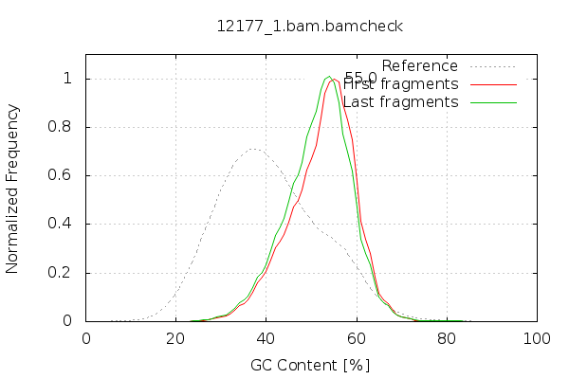
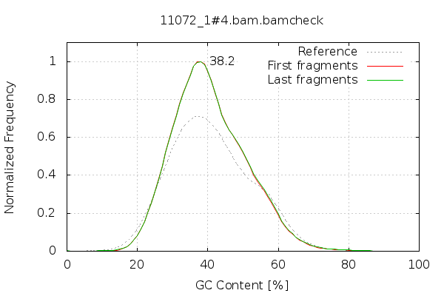
GC of reads

Slide 74
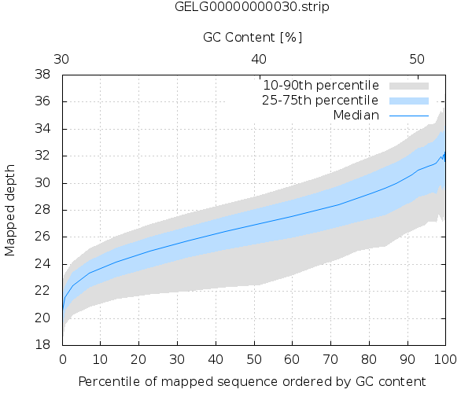
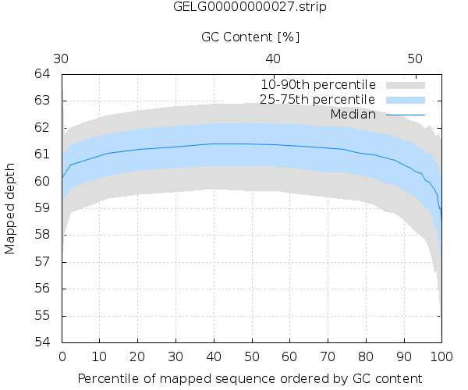
GC vs depth

Slide 75
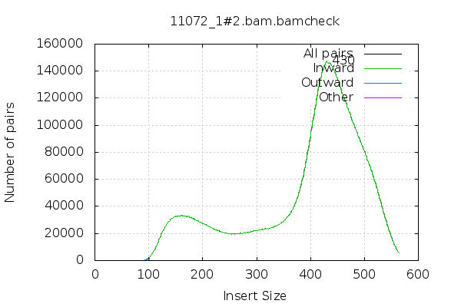
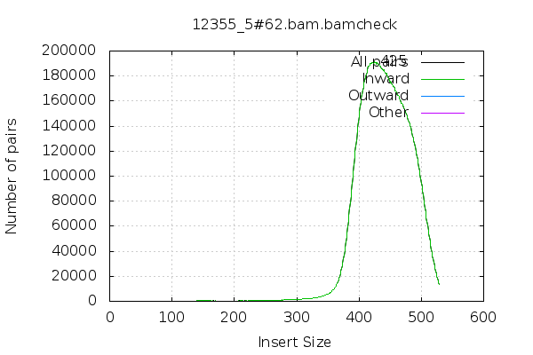
Fragment size

Slide 76
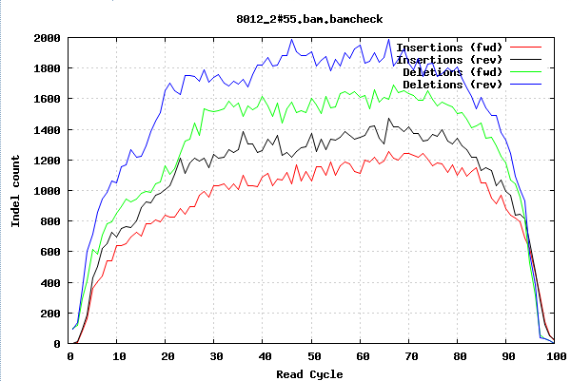
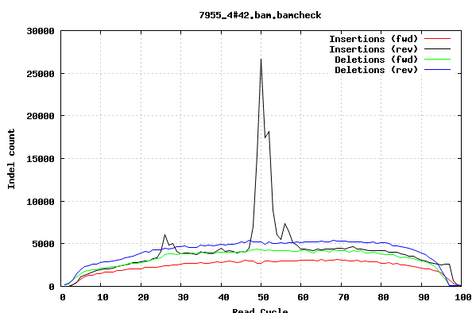
Indels per cycle

Slide 77
Data QC from alignments – a brief revision
QUIZ IS OVER
Notes:
Once you’ve got alignments you can compile statistics which tell you a few things
Whether the sequencing itself was biased: flowcells had problems, or mapping rates were awry
Mapping, duplicate rates
Whether you’ve got the right samples (that’s a genotype check)

Slide 78
Data production workflow
Typically in a production workflow:
One sample spread over multiple seq libraries.
One library spread over multiple seq runs (lanes)
Sample/Platform
Sample
merge
NA34842
NA87465
Library
merge
BAM
BAM
BAM
Library
Freeze
GATK BAM IMPROVEMENT
BAM
BAM
BAM
……
BAM
BAM
BAM
Improvement
POST-ALIGN QC
BAM
BAM
BAM
……
BAM
BAM
This step is the alignment of FASTQ
- We’ve discussed this at length
Alignment
(bwa, smalt, bowtie etc)
Fastq
Fastq
Fastq
……
Fastq
Fastq
Notes:
The next part, if you are happy with the sequencing of your library components, is to do what’s typically called BAM IMPROVEMENT
This is a pair of software processes introduced by GATK during the processing of thousand genome data that actually alter the bam files.

Slide 79
BAM improvement
FIRST - align each separate FASTQ: library x lane
Input: BAM
Process 1: INDEL (local) realignment
Process 2: Base quality recalibration
Output: BAM
Merge independent lanes BAMS in same library together
Process 3: library - level mark-duplication
BAM improvement Part of …
“GATK Best Practice”
Notes:
The first process is call indel realignment
The second is Base Quality Score Recalibration
- And I will describe and motivate them briefly.

Slide 80
BAM Improvement - Indel Realignment
THIS IS NOW DEPRECATED (even by GATK!).
I will mention it briefly because you may see it in different contexts.
PROBLEM: read aligners act on each read individually.
IF the read had an indel,
THEN the aligner might get it right.
OR – if the indel happened near the edge of a read – it may get alignment wrong and miss the indel.
THEN the read would have lots of MISMATCHES instead of a single indel.
Notes:
The process of indel realignment has been deprecated for a few years, but you may come across it in v. old documentation

Slide 81
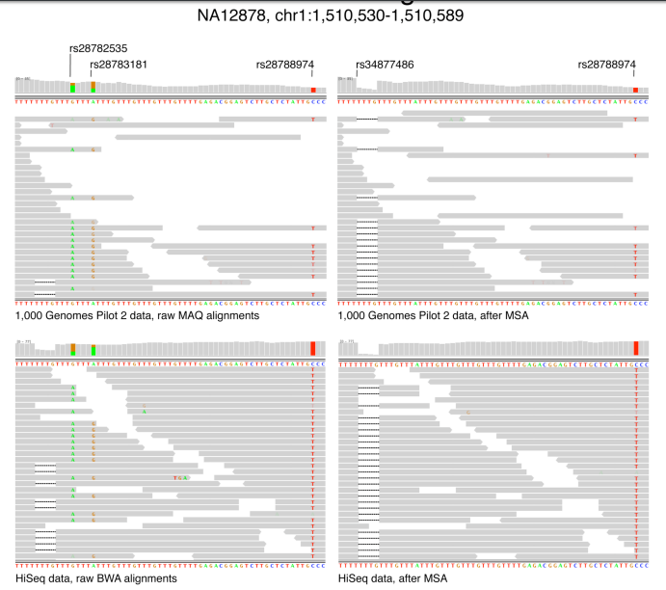
Indel Realignment
M.A. DePristo et al., Nature Genetics 2011
INDEL Realignment algorithm
FOR indel sites and a BAM file
At each site, model the indel haplotype vs the reference haplotype
Which alignment minimises ALL the observed mismatches?
Indel or no indel?
Result: Group alignment for all the reads (not one-by-one)
Result: New BAM file produced with read cigar lines modified where indels have been introduced by the realignment process
“…GTTTGTTTATTT…”
These reads mis-aligned
These SNPs are false
Before Indel Realign
After Indel Realign
Notes:
The process of indel realignment has been deprecated for a few years, but you may come across it in v. old documentation

Slide 82
Indel Realignment
M.A. DePristo et al., Nature Genetics 2011
“…GTTTGTTTATTT…”
These reads mis-aligned
These SNPs are false
Before Indel Realign
After Indel Realign
Notes:
The process of indel realignment has been deprecated for a few years, but you may come across it in v. old documentation

Slide 83
BAM Improvement - Indel Realignment
THIS IS NOW DEPRECATED (even by GATK!).
Reads are getting longer and aligners are getting better – the problem is going away.
Local realignment now automatically performed by variant callers (downstream) ANYWAY.
So GATK have removed it from their ”best practice” docs.
Notes:
The process of indel realignment has been deprecated for a few years, but you may come across it in v. old documentation

Slide 84
BAM Improvement - Base Quality Score Recalibration
Each base call has an associated base call quality
What is the chance that the base call is incorrect?
Illumina evidence: intensity values + cycle
Phred values (log scale)
Q10 = 1 in 10 chance of base call incorrect
Q20 = 1 in 100 chance of base call incorrect
Accurate base qualities essential measure in variant calling
Rule of thumb: Anything less than Q20 is not useful data
BUT:
The base quality scores produced by a sequencer can be influenced by systematic technical error:
They can vary with sequence context, position in read etc.
Therefore the quality score can be off
Therefore variant calling can be influenced.
BQSR: adjusts the quality of each base to adjust for these systematic errors
https://www.ncbi.nlm.nih.gov/pmc/articles/PMC3409179/

Slide 85
Base quality recalibration
The idea of recalibration:
Use the alignment of your reads to a human reference
Remove all known variants dbSNP+1000G etc SNP sites
Assume all other mismatches in your data are sequencing errors
Now you can infer the mean observed (“empirical”) error rate for these bins:
Position of base in read (1 => length of read)
Dinucleotide Sequence Context: AA, AT …, CA, CT …
Empirical quality = number of mismatches / total number in bin.
Compare empirical rate to reported sequencer base quality in each of these categories.
Derive an adjustment for each category, to be applied to each reported base quality value
e.g. Sequencer reports Q25 base calls for a “T” in context “AT"
After alignment - it may be that ”T” in context “AT” actually mismatches the reference at a 1 in 100 rate, so are actually Q20
Adjustment: for every T in “AT” – subtract 5 from BQ. (30=>25, 21=> 16 etc)
NOTE: requires a reference genome and a catalog of variable sites

Slide 86
Base quality recalibration effects

Slide 87
Data production workflow
One sample
…spread over…
Multiple libraries
One library
…spread over…
Multiple runs (lanes)
Sample/Platform
Sample
merge
NA34842
NA87465
We squeeze in a library-level dedup right here.
Library
merge
BAM
BAM
BAM
Library
Freeze
GATK BAM IMPROVEMENT
BAM
BAM
BAM
……
BAM
BAM
BAM
Improvement
POST-ALIGN QC
BAM
BAM
BAM
……
BAM
BAM
This step is the alignment of FASTQ
- We’ve discussed this at length
Alignment
(bwa, smalt, bowtie etc)
Fastq
Fastq
Fastq
……
Fastq
Fastq
Notes:
WE’RE ALMOST DONE.
The last thing I wanted to mention is the de-duplication once you’ve merged to library.

Slide 88
Library duplicates
All second-gen sequencing platforms are NOT single molecule sequencing
PCR amplification step in library preparation
Can result in duplicate DNA fragments in the final library prep.
PCR-free protocols do exist – require larger volumes of input DNA
Problem: can result in false SNP calls
Duplicates manifest themselves as high read depth support
Solution:
Align reads to the reference genome
Identify read-pairs where the outer ends map to the same position on the genome and remove all but 1 copy
Samtools: samtools rmdup
Picard/GATK: MarkDuplicates
Generally low number of duplicates in good libraries (<5%). But I see ~15%
Notes:
This is where duplication comes from:
We should note that PCR amplification is a step in most library preparations.
Therefore, there WILL be duplicate reads in the system, which are not biological.
That’s a problem – it will artificially increase confidence in a variant call.
Once you’ve aligned, though, you can manage this:
Because the PCR dups will have their outer ends at the same genomic position.
So you can spot this and remove all but one read.
There is an expectiation that a typical library will have about 5% dups this way, but I see close to 15% often, so I think it’s library / chemistry dependent.

Slide 89
Data production workflow
One sample
…spread over…
Multiple libraries
One library
…spread over…
Multiple runs (lanes)
Sample/Platform
Sample
merge
NA34842
NA87465
We squeeze in a library-level dedup right here.
Library
merge
BAM
BAM
BAM
Library
Freeze
GATK BAM IMPROVEMENT
BAM
BAM
BAM
……
BAM
BAM
BAM
Improvement
POST-ALIGN QC
BAM
BAM
BAM
……
BAM
BAM
This step is the alignment of FASTQ
- We’ve discussed this at length
Alignment
(bwa, smalt, bowtie etc)
Fastq
Fastq
Fastq
……
Fastq
Fastq
Notes:
This last slide is just a reminder that alignment is just one part of the process that gets you from fastq to sample-level BAM, which you can run analysis on.

Slide 90
Overview
If you are an consumer then you should have a grasp of this
Intro
Methods / Aligners
Alignment Outputs
Alignment Viewers
Alignment summary statistics and QC – BRIEF REVISION
After alignment: BAM file improvement before variant calling
An informatics group should have control of this, but you should be aware that it’s being done.

